Slide 1
Process Synchronization
— Chapter 6
2021年10月
叶 文
yewen@bupt.edu.cn
School of Computer Science (National Pilot Software Engineering School)

Slide 2
Synchronization vs Mutual Exclusion
P_{i}
P_{j}
synchronization
e.g. 四乘一百米接力
mutual exclusion
e.g. DB access
resources

Slide 3
Outline
Synchronization Concepts(§6.1)
why synchronization needed, race condition
Critical section problem and its necessary conditions (§6.2)
process synchronization requirement scan be described as the critical section problem
Synchronizing mechanisms
application program-level
software algorithms (§6.3) , e.g. Peterson, Bakery
hardware-level
synchronization hardware (§6.4) (*了解*)
OS-level
semaphores (信号量，§6.5/6.6)
programming environments or system software-levels high-level language synchronization constructs, including
monitors (管程§6.7)

Slide 4
Outline
Classical problems of synchronization by semaphores (§6.6) (*掌握*)
bounded- buffer problem
readers-writers problem
dining-philosophers problem
Case studies (§6.8) (*知道*)
synchronization in Linux
synchronization in Solaris2 & Windows XP
做题，上机实验！！

Slide 5
6.1 Background
Cooperating processes vs independent processes in computers (§3.4, P96)
process cooperating in four conditions
Shared resources
the resources (e.g., data, CPU, I/O ports, memory) that can be accessed by several cooperating processes concurrently
the shared resources cannot be used by several processes simultaneously (or in parallel), only be used mutual exclusively(互斥).
Shared data as shared resources
concurrent access to shared data in DBS may result in data inconsistency
Maintaining data consistency requires mechanisms to ensure the orderly execution of cooperating processes
process synchronization is needed
e.g. transaction management in DBS (§6.9)

Slide 6
Bounded-Buffer Problem
Also known as Producer-consumer problem
synchronization among
producers
consumers
producers and consumers
out
full
in
out
in
empty

Slide 7
Bounded-Buffer Problem
Shared-memory solution to bounded-buffer problem (Chapter 3)
allows at most n – 1 items in buffer at the same time
adding a variable counter, initialized to 0 and incremented each time a new item is added to the buffer
Codes for bounded-buffer problem
#define BUFFER_SIZE 10
typedef struct {
. . .
} item;
item buffer[BUFFER_SIZE];
int in = 0; int out = 0; int counter = 0;

Slide 8
Bounded-Buffer Problem
Producer process
while (1) {
// producing an item in nextProduced */
while (counter == BUFFER_SIZE) ;
/* do nothing */
buffer[in] = nextProduced;
in = (in + 1) % BUFFER_SIZE;
counter++;
}
Consumer process while (1) {
while (counter == 0) ;
/* do nothing */
nextConsumed = buffer[out];
out = (out + 1) % BUFFER_SIZE;
counter--;
/* consume the item in nextConsumed */
}

Slide 9
Bounded-Buffer Problem
counter is shared data, the statements counter++; counter--; must be performed atomically
Atomic operation means an operation that completes in its entirely without interruption. Otherwise, data inconsistency will occur.
An Example: executing of counter++ and counter -- atomically
if the producer and the consumer access counter sequentially, data consistency can be maintained
e.g. counter=5; counter ++; counter --; the result remains counter=5
the statement “count++” and “count--”may be implemented in machine language as
register1 = counter
register1 = register1 + 1 counter = register1
register2 = counter
register2 = register2 - 1 counter = register2

Slide 10
Bounded-Buffer Problem
Counter-example: executing of counter++ and counter in interleaving manner
both the producer and consumer attempt to update the buffer concurrently, the assembly language statements may get interleaved(交织)
interleaving depends upon how the producer and consumer processes are scheduled, and may result in inconsistent data
assume counter is initially 5. One interleaving of statements is:
Problems
the value of count may be either 4 or 6, where the correct result should be 5
producer: register1 = counter (register1 = 5) producer: register1 = register1 + 1 (register1 = 6) consumer: register2 = counter (register2 = 5)
consumer: register2 = register2 – 1 (register2 = 4) producer: counter = register1 (counter = 6) consumer: counter = register2 (counter = 4) .

Slide 11
Why synchronization needed: Race Condition
Race condition(竞争条件)
the situation where several processes access and manipulate shared data concurrently
the final value of the shared data depends upon which process finishes last
Po prevent race conditions, concurrent processes must be synchronized, i.e. access shared resources in mutual exclusory methods

Slide 12
6.2 The Critical-Section Problem
Some concepts related to Critical-Section Problem
n processes, all competing to use some shared data
Critical section (临界区/段)
each process has a code segment, called critical section, in which the shared data is accessed.
Critical resources
resources accessed by Critical section
Requirement – ensure that when one process is executing in its critical section to access critical resources, no other process is allowed to enter its critical section

Slide 13
General Structure of Process
General Structure of Process
do {
…….
entry section(R)
critical section(R)
exit section(R)
reminder section
} while (1);
// apply
// use
// release

Slide 14
Solution to Critical-Section Problem
Ncessary conditions for correct solutions to critical-section problems
mutual exclusion
progress
bounded waiting
Mutual exclusion
if process P_{i} is executing in its critical section specific to the resource R, then no other processes can be executing in their critical sections specific to R
/*互斥地执行临界区代码
what is mutual exclusion (互斥)
a programming technique ensuring that only one program or routine at a time can access some resources, such as a memory, an I/O port, or a file

Slide 15
Mutual Exclusion
Suppose Process P₁ and P₂ concurrently access resource R₁ (e.g. main memory) and R₂ (e.g. I/O devices), so each process has two critical sections responding to R₁ and R₂ respectively
P₁ and P₂ may be simultaneously stay in its critical sections, however access different resources, i.e. R₁ and R₂
P₁
entry section(R₁)
critical section(R₁)
exit(R₁)
entry section(R₂)
critical section(R₂)
exit(R₂)
P₂
entry section(R₂)
critical section(R₂)
exit(R₂)
entry section(R₁)
critical section(R₁)
exit(R₁)

Slide 16
Progress
Progress
if no process is executing in its critical section (共享资源空闲) and there exist some processes that wish to enter their critical section, then
(1) only those processes that are not executing in their reminder sections can participate in the decision on which will enter its critical section next, and
// 挑选进入临界区的进程时，不考虑那些正在reminder 区中 执行的进程(已经使
用完临界资源)；
或：只考虑那些正处于entry(申请进入)、critical sections和exit sections 的进程
临界区外的进程不应阻塞其它进程
(2) this selection cannot be postponed indefinitely
// 挑选过程不应被无限期阻止

Slide 17
P₀
reminder
P₅
P₃
entry
P₂
critical
P₄
exit
P₁
reminder

Slide 18
Bounded Waiting
Bound waiting
a bound or limit must exist on the number of times that other processes are allowed to enter their critical sections after a process has made a request to enter its critical section and before that request is granted
当一个进程申请进入临界区并还未得到许可时，应当限制其它进程进入临界区的次数。否则，会导致该进程在临界区外无休止等待——进程在临界段内只应停留有限时间
to avoid deadlock or starvation
Counter-example
priority-based preemptive CPU scheduling, the process with lower priority may be starved

Slide 19
进程互斥使用临界资源的原则
在共享同一个临界资源的所有进程中，每次只允许一个进程处于它的临界段中
若有多个进程同时要求进入它的临界段，应在有限时间内让其中之一进入，而不应相互阻塞使得各进程都无法进入临界段
进程在临界段内只应停留有限时间
不要使需要进入临界段的进程无限制地等待在临界段之外
处于剩余段的进程不应阻止其他进程进入临界段

Slide 20
6.3 Peterson Solution
In user mode, a software-based solution to process synchronization
G.L.Peterson (1981) algorithm
for synchronizing of two processes
Bakery Algorithm
critical section solution for n processes

Slide 21
Peterson Solution
the structure of process P_{i}
enter_section ( i ); //判断是否可安全进入，如不能，等待
critical_section(i);
exit_section ( i ); //退出时，应允许其它进程进入临界段
reminder section (i);

Slide 22
For processes P_{i} and P_{j}, shared variables
boolean flag [2];
/* flag [i] = true ⇒ P_{i} ready/want/apply to enter its critical section */
initially flag [i] = flag [j] = false.
int turn; /*轮到谁？*/
turn == i ⇒ P_{i} are allowed to enter its critical section
initially turn = 0

Slide 23
Process P_{i}
do {
flag [i]= true; /*表明自身请求进入临界区*/
turn = j; /* 假设先轮到对方进入临界区 */
while (flag [j] and turn == j)
{ do-nothing };
/*对方正在临界区中, P_{i}忙等待*/
critical section
flag [i] = false /*表明自身不再需要进入临界区*/
remainder section
} while (1);
enter_section
exit_section

Slide 24
当P_{i}和P_{j}同时申请访问临界资源时，微观上先申请者(先置位turn) 先进入临界区 ，假设：单CPU系统
P_{i} P_{j}
flag [i]= true
flag [j]= true
turn = j;
turn = i;
false: flag [j] and turn == j
true: flag [i] and turn == i
critical section i busy waiting
timeline

Slide 25
Peterson Solution (cont.)
Features
this algorithm is correct
— meets requirements of mutual exclusion, progress, bounded-waiting;
—a solution to critical-section problem for two processes ()
combing the shared variables in algorithms 1 and 2.
demerit
— busy-waiting
P_{i} alternatively stays in running and ready states

Slide 26
It is assumed that:
P_{i} is in its critical section, and P_{j} is in the busy- waiting state
2. time-sharing scheduling:
time slots ts[i](e.g. 50ms) are assigned to P_{i} and P_{j} alternatively
ready
P_{i}, P_{j}
running
enter section in critical section
exit section and in remainder section
ts[1]
ts[3]
ts[5]
ts[7]
ts[9]
while (flag [j] and turn == j)
P_{i}:
running
ready
running
ready
running
ready
running
ready
running
flag [i]←true
turn← j
While-false;
critical section
flag[i]←false
ts[2]
ts[4]
ts[6]
ts[8]
ts[10]
while (flag [i] and turn == i)
P_{j}:
ready
running
ready
running
ready
running
ready
running
ready
running
flag [j]←true
turn← i
while-false;
critical section
critical section
while-true;
running and in
enter section/busy-waiting
running and in critical section
running and
in remainder section

Slide 27
Bakery Algorithm
An software solution for synchronize among n processes
Principles
before entering its critical section, process receives a number (denoted for ticket #)
the holder of the smallest number enters the critical section.
if processes P_{i} and P_{j} receive the same number, if i < j, then P_{i} is served first; else P_{j} is served first.
the numbering scheme always generates numbers in increasing order of enumeration; i.e., 1,2,3,3,3,3,4,5...

Slide 28
Bakery Algorithm (cont.)
Notes : for lexicographical order (ticket #, process id# )
(a,b) < ( c,d) if a < c or if a = c and b < d
max (a₀,…, a_{n-1}) is a number k, such that k ≥ a_{i} for i =0,.. , n – 1
Shared data
boolean choosing[n];
/* choosing[i]=true: P_{i} begins/wants to apply for ticket*/
int number[n]; /* number[i]: ticket# for P_{i} ,
number[i]>0 表示P_{i}需要进入临界区: */
data structures are initialized to false and 0 respectively

Slide 29
Process P_{i}
time slots (e.g. 50ms) are assigned to processes alternatively
do {
choosing[i] = true; /*begin to apply for ticket*/
number[i]
= max(number[0], number[1], …, number[n – 1]) + 1;
/* a ticket whose number is maximum is given ,
first come first given, in non-decreasing order */
choosing[i] = false; /* end application */
for (j = 0; j < n; j++) /*考虑所有进程*/
{
while (choosing[j]) ; /*如有其它进程正在申请ticket, 等待P_{j}申请完*/
while ((number[j] != 0) && {(number[j], j) < (number[i,], i)}) ;
/*如有票号小于自身的其它进程P_{j} 正在或等待运行，
等待P_{j}访问完*/
}
Pi和Pj两个进程，采用时间片轮转，申请票号。Pi在第一个时间片内读取其他进程的最大number=5，在还没有完成通过max操作将number[i]设置为6的时候，CPU切换到Pj，Pj读取到的其他进程最大值仍然是number=5， 通过max获取的票号也将是6

Slide 30
critical section /*进入临界区, 访问临界资源*/
number[i] = 0; /*丢弃使用过的票，退出临界区*/
remainder section
} while (1);
Features
Bakery algorithm is correct
demerit: busy-waiting, while

Slide 31
6.4 Synchronization Hardware (略)
Three schemes
TestAndSet Instruction
Swap Instruction
Interrupt masking(中断屏蔽)
Principles of TestAndSet Instruction and Swap Instructions
每个临界资源设置一个布尔变量lock，初值为false，lock用机器字实现
CPU提供专门的硬件指令TestAndSet 或Swap，允许对一个字的内容进行检测和修正，或交换两个字的内容
硬件指令可以解决共享变量的完整性和正确性，防止出现race condition
进程在enter_section中利用原子操作TestAndSet 指令或 Swap 指令测试lock, 察看临界资源是否空闲, 从而决定是否进入critical section

Slide 32
Synchronization Hardware (cont.)
Properties
简单、有效，特别适用于多处理机
缺点：忙等待
for more details about TestAndSet Instruction and Swap Instruction, refer to Appendix 6-1

Slide 33
Synchronization Hardware (cont.)
Interrupt masking based hardware synchronization
“开关中断”指令保证用户态下的进程在临界区执行时不被其它进程中断,从而实现多个进程互斥访问临界区
进入临界区前执行：“关中断”指令
离开临界区后执行：执行“开中断”指令
简单，有效
较高的代价，限制CPU并发能力(临界区大小)
不适用于多处理器

Slide 34
6.5 Semaphores
Semaphore definitions
synchronization tools that may avoid busy waiting
provided by OS, working in kernel space
由操作系统在内核空间提供的一种用于多个合作进程间同步与互斥的机制
信号量也被称为锁(lock)
但在许多情况下，锁专指二元信号量，主要用于进程互斥。
Representation of Semaphore S
integer variable, binary or non-binary
two standard operations modify S:
wait() and signal()
, originally called P() and V() [早期教科书中]
ready
running
waiting

Slide 35
Semaphores
Operations on semaphore S
initialization (S)
initialize S to a value
ready
running
wait (S) {
while S ≤ 0 do no-op;
/* the process that issues
this operation is waiting*/
S--;
}
signal (S) {
S++;
}
time-sharing scheduling, time slots (e.g. 50ms) are assigned to processes alternatively
Wait() may results in process busy waiting

Slide 36
信号量S的物理意义
针对无忙等待的多元信号量
S对应于临界/共享资源
S ( >0 ) ——可用共享资源的数目
S (=< 0 ) —— 无共享资源可用，|S|表示因请求使用S而被等待或阻塞的进程 (注：针对不带有忙等待的信号量)
wait()
请求分配一个单位的资源S给执行wait操作的进程
signal()
进程释放一个单位的资源S
wait and signal in commercial OS
in Windows, WaitForSingleObject()
ReleaseSemaphore()
In Linux, down(), up()

Slide 37
信号量三种用法
1.资源互斥使用
资源只有1个实例，各个进程通过二元信号量mutex互斥地进入临界区，使用资源
Mutex：代表资源的控制权，初值为1
e.g. 生产者-消费者问题中的buffer
2.资源竞争使用
资源有多个实例，允许多个进程竞争使用资源
多元信号量表示：1)资源可用数目，2) 资源使用权
e.g. empty, full in the bounded-buffer problem
3.进程间同步
进程间的执行步骤需要有先后顺序关系
同步二元信号量sync，初值为0

Slide 38

P/V Operations on Semaphores
信号量的概念是由荷兰计算机科学家E.W.Dijkstra在1962年或者1963提出的
Dijkstra及其团队正在为Electrologica X8开发一款操作系统（该系统后来被称为THE多道程序系统），他提出了用P、V操作实现进程的同步与互斥
P和V分别取自荷兰语的测试(Proberen)和增加(Verhogen)的首字母
P、V操作也称为wait、signal操作
最初，Dijkstra提出的是二元信号量(互斥)，后来推广到一般信号量(多值，同步)
Edsger Wybe Dijkstra9 (1930-2002)
出生于荷兰，美国Texas大学计算机科学和数学教授
Dijkstra单源最短路径算法的发明者
Turing Prize Winner (1972)
因ALGOL第二代编程语言，获得图灵奖
“Go To Statement Considered Harmful”(EWD215): 被广为传颂的经典之作

Slide 39
Example
Considering n=10 processes, which mutual exclusively use the resource type R of m=6 instances
A semaphore S is designed to synchronize these processes. The maximum and minimal values of R are respectively
A. 10, -4 B. 6, -4
C. 10, 6 D. 6, -10
value range of S：[m-n, m], e.g. n=10, m=6

Slide 40
Semaphore Usage
Two types of semaphores
Counting semaphore (计数、一般信号量)
integer value can range over an unrestricted domain
用于进程间同步、互斥
the value corresponds to the number of shared resources usable
Binary semaphore (二元信号量)
integer value can range only between 0 and 1, be simpler to implement
用于进程间互斥
binary semaphore 也称为mutex lock (互斥锁)
同步：相互协作多个进程间，由于需要协调它们的工作而相互等待，或需要相互交换信息而产生的制约关系
互斥：进程间因相互竞争使用临界资源而产生的制约

Slide 41
Usage in Mutual Exclusion
Mutual exclusion for n processes to concurrently access resource R
shared data/resource R by n processes
semaphore mutex; /* corresponding to shared data/resource,
initially mutex = 1
Process P_{i}: do { wait(mutex) ; critical section
signal(mutex) ; remainder section } while (1);
针对共享资源R，
设立mutex

Slide 42
Usage in Synchronization
Synchronizing of n processes
concurrent process P₁ with statement S₁ and process P₂ with statement S₂
requirement: S₂ should be executed only after S₁ has completed
P₁ and P₂ share semaphore synch (表示S1是否已经执行完) which is initialized to 0
P₁: M1;
S₁;
signal(synch);
P₂: M₂
wait(synch);
S₂;

Slide 43
Example One
Consider processes P1, P2, and P3 in the following figures.
in Fig. (a), only after P1 ends, can P2 begin. And only after P2 ends, can P3 begin;
in Fig. (b), only after both P1 and P2 end, can P3 begin;
in Fig. (c), only after P1 ends, can both P2 and P3 begin
Define semaphores, and synchronize the execution of P1, P2, and P3 by wait() and signal() on these semaphores. Assuming the main bodies of P1, P2, and P3 are as follows
P1: P2: P3:
begin begin begin
S1; S3; S5;
S2; S4; S6;
end end end

Slide 44
P1
P2
P3
Fig. (a)
P1
P3
P2
Fig. (b)
P2
P1
Fig. (c)
P3

Slide 45
Example One
Initially, defining and initializing binary semaphores S1 and S2 as:
(binary) semaphores mutex1, mutex2;
sync1:=0, sync2:=0;
For processes in Fig. (a)
P1: P2: P3:
begin begin begin
S1; wait(sync1); wait(sync2);
S2; S3; S5;
signal(sync1); S4; S6;
end signal(sync2); end
end;
P1
P2
P3
Fig. (a)

Slide 46
Example One
For processes in Fig. (b)
P₁: P₂: P₃:
begin begin begin
S1; S3; wait(sync1-3);
S2; S4;; wait(sync2-3);
signal(sync1-3); signal(sync2-3); S5;
end end S6:
end
P₁
P₃
P₂
Fig. (b)

Slide 47
A
C
B
E
D

Slide 48
A
C
B
E
D

Slide 49
Example One
Error solution for process synchronization in Fig. (b)
P₁: P₂: P₃:
while(true){ while(true){ while(true){
begin begin begin
S1; S3; wait(sync);
S2; S4;; wait(sync);
signal(sync); signal(sync); S5;
} } S6:
}
问题：
可能存在P₁连续运行两轮，两次signal()操作，导致P₃启动运行
P₁
P₃
P₂
Fig. (b)

Slide 50
Example One
For processes in Fig. (C)
P₁: P₂: P₃:
begin begin begin
S1; wait(sync1-2); wait(sync1-3);
S2; S3; S5;
signal(sync1-2); S4; S6:
signal(sync1-3); end end
end
P₂
P₁
P₃
Fig. (c)

Slide 51
Example One
Error solution for process synchronization in Fig. (C)
P₁: P₂: P₃:
begin begin begin
S1; wait(sync); wait(sync);
S2; S3; S5;
signal(sync); S4; S6:
signal(sync); end end
end
问题：
可能存在P₁执行两次signal()操作后， P₂连续运行两轮，执行两次wait()操作，导致P₃无法启动
P₂
P₁
P₃
Fig. (c)

Slide 52
Example Two
用信号量描述4 乘100 米接力过程
(binary) semaphores S1, S2, S3;
/* S_{i} 代表 第[i]棒是否跑完，第[i+1]棒是否可开始，
i= 1, 2, 3
initially, S1=S2=S3=0
P1: P2: P3: P4:
发令枪响 wait(Sl); wait(S2); wait(S3);
起跑， 起跑， 起跑， 起跑，
前进l00m; 前进l00m 前进l00m 前进l00m;
signal(S1); signal(S2); signal(S3); 到达终点

Slide 53
Semaphores Without Busy Waiting
Define a semaphore S as a C struc
typedef struct {
int value; struct process *list;
/*因S而阻塞/等待的进程队列*/ } semaphore;
Assume two simple operations
block
suspends the process that invokes it, i.e., the process are changed into blocked (i.e. waiting) state
wakeup(P)
resumes the execution of a blocked process P.

Slide 54
Semaphores Without Busy Waiting
Operations on counting (non-binary) semaphore defined as
wait(S){
S.value--; /*申请一个单位的资源/
if (S.value < 0) { /*无可用资源*/
add this process to S.list; block();
} }
compared with busy-waiting wait()
signal(S) { S.value++; /*释放一个单位的资源*/
if (S.value <= 0) /*仍有被阻塞进程*/
{ remove a process P from S.list; wakeup(P); /*唤醒被阻塞进程*/
}
}
compared with busy-waiting signal()

Slide 55
Semaphores Without Busy Waiting
Operations on binary semaphore defined as
waitB(S){
if S.value=1
then S.value=0; else { add this process to S.L
block();
} }
compared with busy-waiting wait()
signalB(S) { if S.L is empty / there is no process
blocked and S.value is 0
the S.value=1
else { remove a process P from S.L;
wakeup(P) /*唤醒被阻塞进程*/
}
}
A counting semaphore S can be implemented as a binary semaphore and an integer variable

Slide 56
Deadlock
Deadlock definition
states/situations related to more than one process in the system , in which the processes are waiting indefinitely for an event or events (e.g., resources acquisition and release) that can be caused by only one of the waiting processes.
Deadlock
系统内多个并发进程彼此互相等待对方所拥有的资源，且这些并发进程在得到对方的资源之前不会释放自己所拥有的资源，造成各个进程都想得到资源而又都得不到资源，各并发进程不能继续执行的状态.

Slide 57
Deadlock Example
Let S and Q be two semaphores initialized to 1
P₁ P₂
wait(S);
wait(Q);
wait(Q);
wait(S);
 
signal(S);
signal(Q);
signal(Q);
signal(S);
P₁
P₂
拥
有
S
拥
有
Q
要求S
要求Q
S
Q
Semaphore S for resource S, Semaphore Q for resource Q

Slide 58
Starvation
Starvation
states /situations related to a process (or some processes), in which the process may never be removed from the semaphore queue in which it is suspended, or a process waits indefinitely within the semaphore.
infinite waiting or blocking
Another example of process starvation
the process with lower priority may be starved in priority based CPU scheduling

Slide 59
不允许用户应用程序在用户态下直接对信号量操作
信号量是OS提供的一种内核空间进程同步互斥机制
在用户态下运行的用户应用程序只能通过wait()、signal()等系统调用，间接地操纵修改信号量
不允许用户应用程序直接在用户态下修改信号量
反例。 defining semaphore S
main{
…
S := S – 1
if S > 0 then …
else …
}

Slide 60
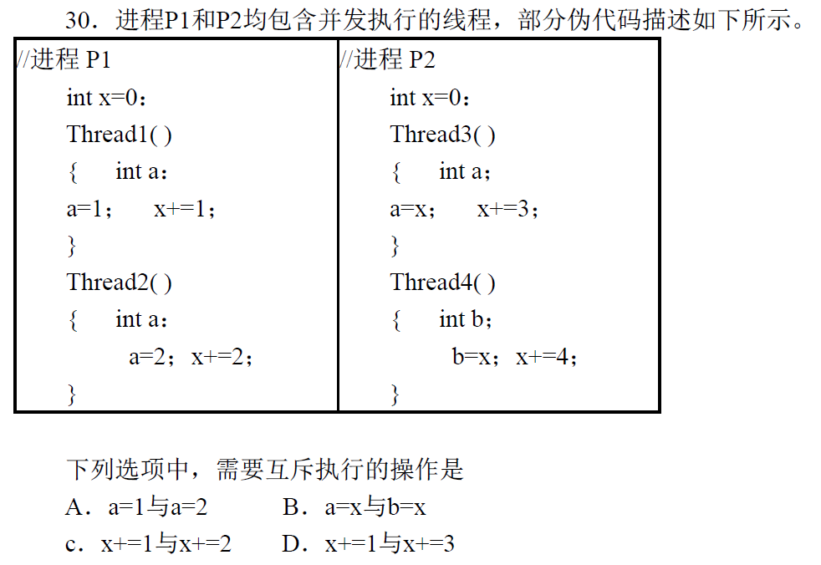
写thread1和thread2中的局部变量，不冲突
读P2中全局变量x，分别写thread3和thread4各自局部变量，不冲突
对P1中全局变量x，分别由thread1和thread1写，冲突
thread1对P1中全局变量x写，thread3对P2中的全局变量x写，不冲突

Slide 61
Example
如下代码片段展示了两个线程thread1、thread2所执行的函数，以及执行这2个线程前的初始化代码init。
如果需要保证这两个线程都一定可以终止运行，填写下面代码中的空出部分。
注意
thread1、thread2函数中，只能填写signal()、wait()，每个空位可填写的操作数量不限
原理
thread1、thread2对共享变量x分别进行乘二、乘三操作，需要保证x的值经过这两个线程的访问之后，x=12，从而thread1、thread2跳出while循环，可exit()结束
设置同步、互斥信号量，使得两个线程从x=1开始，按照：
x=x*2; x=x*3; x=x*2，
或者： x=x*2; x=x*2; x=x*3，…

Slide 62
1 int x=1;
2 struct sem a, b, c
3
4 void init()
5 {
6 a->value= ;
7 b->value= ;
8 c->value= ;
9 }
10
11 void thread1();
12 {
13 while (x !=12) {
14 ;
15 x = x*2;
16 ;
17 }
18 exit(0);
19 }
20
21 void thread2();
22 {
23 while (x !=12) {
24 ;
25 x = x*3;
26 ;
27 }
28 exit(0);
29 }
30
原理：
1. 12=2*2*3
2. 通过thread1和thread2间的同步、互斥信号量，控制thread1的循环体执行2次，thread2的循环体执行1次

Slide 63
6.6 Classical Problems of Synchronization
Bounded-Buffer Problem
POSIX/Pthread semaphore-based solution
Readers-Writers Problem
POSIX/Pthread semaphore-based solution
Dining-Philosophers Problem
Sleeping-barber problem

Slide 64
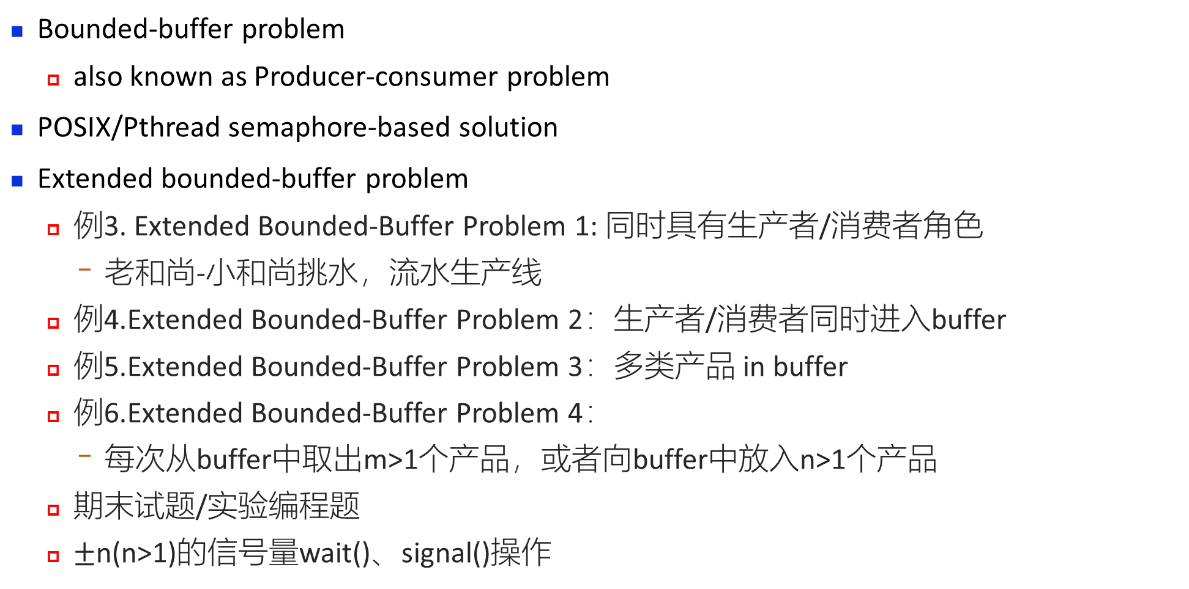
6.6.1 Bounded-Buffer Problem
Bounded-buffer problem
also known as Producer-consumer problem
POSIX/Pthread semaphore-based solution
Extended bounded-buffer problem
例3. Extended Bounded-Buffer Problem 1: 同时具有生产者/消费者角色
老和尚-小和尚挑水，流水生产线
例4.Extended Bounded-Buffer Problem 2：生产者/消费者同时进入buffer
例5.Extended Bounded-Buffer Problem 3：多类产品 in buffer
例6.Extended Bounded-Buffer Problem 4：
每次从buffer中取出m>1个产品，或者向buffer中放入n>1个产品
期末试题/实验编程题
$±$n(n>1)的信号量wait()、signal()操作

Slide 65
Bounded-Buffer Problem
Also known as Producer-consumer problem
Mutual exclusion among
producers
consumers
producers and consumers
Mutual exclusion objects
empty units, full units in the buffer
out
full
in
Consumers
Producers
out
in
empty

Slide 66
Bounded-Buffer Problem
E.g.1 mail-based inter-process communications
E.g.3 A production pipeline consisting of 3 steps, i.e. A, B, and C, and each step holds a bounded buffer to store the components produced
A
C
B

Slide 67
Bounded-Buffer Problem
Semaphores
Mutex
binary semaphore, guaranteeing mutual exclusively operating on the buffer, i.e. only one process is allowed to operate on the buffer
Full
full-buffer-units available
作为counting semaphore，计数缓冲区中产品数量
Empty
empty-buffer-unit available
Initially
full = 0,
empty = n
mutex = 1

Slide 68
Producer Process
313-314
3
do {
…
produce an item in nextp
…
wait(empty); /*是否有空单元*/
wait(mutex); /*是否可向buffer/空单元写，或是否有其它进程在操作buffer*/
…
add nextp to buffer
…
signal(mutex); /*允许其它进程访问*/
signal(full); /*满单元数加1，唤醒被阻塞的消费者*/
} while (1);

Slide 69
producer
consumer
do { …
produce an item in nextp
…
wait(empty);
/*是否有空单元
wait(mutex);
/*是否可向buffer/空单元写
，或是否有其它进程在操作buffer
…
add nextp to buffer
…
signal(mutex);
/*允许其它进程访问
signal(full);
/*满单元数加1，唤醒被阻塞消费者
} while (1);
do {…
wait(full)
/*是否有满单元
wait(mutex);
/*是否可从buffer/满单元读
…
remove an item from buffer to nextc
…
signal(mutex);
/*允许其它进程访问
signal(empty);
/*空单元数加1，唤醒被阻塞的生产者
…
consume the item in nextc
…
} while (1);

Slide 70
上机作业/试题
An assembly line is to produce a product C with four part As, and three part Bs 【C = 4A + 3B】
The worker of machining(加工) A and worker of machining B will produce two part As and one part B independently each time. Then the two part As or one part B will be moved to the station(工作台), which can hold at most 12 of part As and part Bs altogether
Two part As must be put onto the station simultaneously
worker A一次生产2个A，必须一次性放入工作台
The workers must exclusively put a part on the station or get it from the station. In addition, the worker to make C must get all part of As and Bs for one product once.
worker C必须一次性获得所需的4个A、3个B
Using semaphores to coordinate the three workers who are machining part A, part B and the product C to manufacture the product without deadlock. It is required that
(1) definition and initial value of each semaphore, and
(2) the algorithm to coordinate the production process for the three workers
should be given

Slide 71
Cautions
To avoid deadlock,
for the producer processes, the operation wait(empty) should be executed before wait(mutex)
先判断有无空单元（是否有访问buffer的必要），再执行wait(mutex)，获取对buffer的访问权
for the consumer processes, the operation wait(full) should be executed before wait(mutex)
先判断有无满单元（是否有访问buffer的必要），再执行wait(mutex)，获取对buffer的访问权
如果wait操作执行顺序不当，有可能产生死锁
In exit sections, producers/consumers release the buffer at first by signal(mutex), to permit other producers/consumers to access the buffer as early as possible

Slide 72
POSIX/Pthread Semaphore-based Solution
Unix/Linux系统提供了两类标准信号量
System V, POSIX/Pthread
POSIX/Pthread信号量接口
信号量定义
typedef union
{
char __size[__SIZEOF_SEM_T];
long int __align;
} sem_t;

Slide 73
POSIX/Pthread Semaphore-based Solution
信号量初始化/赋初值
/Initialize semaphore object SEM to VALUE. If PSHARED then share it with other processes/
extern int sem_init (sem_t *__sem, int __pshared, unsigned int __value)
信号量wait()、signal()操作
/* wait for SEM being posted./
extern int sem_wait (sem_t *__sem)
获取信号量当前值
/* Get current value of SEM and store it in *SVAL. */
extern int sem_getvalue (sem_t *__restrict __sem, int *__restrict __sval)
撤销信号量
/* Free resources associated with semaphore object SEM*/
extern int sem_destroy (sem_t *__sem)
/* Post SEM. signal()操作/
extern int sem_post (sem_t *__sem)

Slide 74
POSIX/Pthread Semaphore-based Solution
#include <stdio.h>
#include <stdlib.h>
#include <errno.h>
#include <pthread.h>
#include <semaphore.h>
#define N 10
typedef int item;
// 环形队列
int in = 0, out = 0;
// 缓冲区
item buffer[N];
// 互斥、空缓冲区、满缓冲区信号量
sem_t mutex, empty, full;

Slide 75
POSIX/Pthread Semaphore-based Solution
初始化
#include <stdio.h>
#include <stdlib.h>
#include <errno.h>
#include <pthread.h>
#include <semaphore.h>
#define N 10
typedef int item;
// 环形队列
int in = 0, out = 0;
// 缓冲区
item buffer[N];
// 互斥、空缓冲区、满缓冲区信号量
sem_t mutex, empty, full;

Slide 76
显示缓冲区内容
void show_buffer() {
printf("in=%d, out=%d\n", in, out);
printf("[");
if(in == out) // 满了
for(int i=0; i<N; ++i) printf("%2d", buffer[i]);
else if(out < in)
for(int i=out; (i%N)<in; ++i) printf("%2d", buffer[i]);
else {
for(int i=out; i<N; ++i) printf("%2d", buffer[i]);
for(int i=0; i<in; ++i) printf("%2d", buffer[i]);
}
printf(" ]\n");
}

Slide 77
生产者
void* producer(void* id) {
while(true) {
item nextp = rand() % 10;
sem_wait(&empty); //wait()操作
sem_wait(&mutex);
buffer[in] = nextp;
in = (++in)%N;
printf("======%s======\n", (char*)id);
printf("生产了：%d\n", nextp);
show_buffer();
sem_post(&mutex); //signal()操作
sem_post(&full);
}
}

Slide 78
消费者
void* consumer(void* id) {
while(true) {
sem_wait(&full);
sem_wait(&mutex);
item nextc = buffer[out];
out = (++out)%N;
int emp, ful;
sem_getvalue(&empty, &emp);
sem_getvalue(&full, &ful);
printf("======%s======\n"
"缓冲区大小：%d\n"
"消费的物品：%d\n"
"空缓冲区数量：%d\n"
"满缓冲区数量：%d\n"
,(char*)id, N, nextc, emp, ful);
(char*)id, N, nextc, emp, ful);
show_buffer();
sem_post(&mutex);
sem_post(&empty);
}
}

Slide 79
int main()
{
//初始化信号量
if(sem_init(&mutex, 0, 1) == -1) perror("sem_init");
if(sem_init(&empty, 0, N) == -1) perror("sem_init");
if(sem_init(&full, 0, 0) == -1) perror("sem_init");
// 2个生产者、2个消费者pthread_t p1, p2, c1, c2, 并发执行
if(pthread_create(&p1,null, producer, (void*)"生产者1")) perror("pthread_create");
if(pthread_create(&p2,null, producer, (void*)"生产者2") perror("pthread_create");
if(pthread_create(&c1,null, consumer, (void*)"消费者1") perror("pthread_create");
if(pthread_create(&c2,null, consumer, (void*)"消费者2")) perror("pthread_create");

Slide 80
if(pthread_create(&c2,null, consumer, (void*)"消费者2")) perror("pthread_create");
if(pthread_join(p1, null)) perror("pthread_join");
if(pthread_join(p2,null)) perror("pthread_join");
if(pthread_join(c1,null)) perror("pthread_join");
if(pthread_join(c2,null)) perror("pthread_join");
return 0;
}

Slide 81
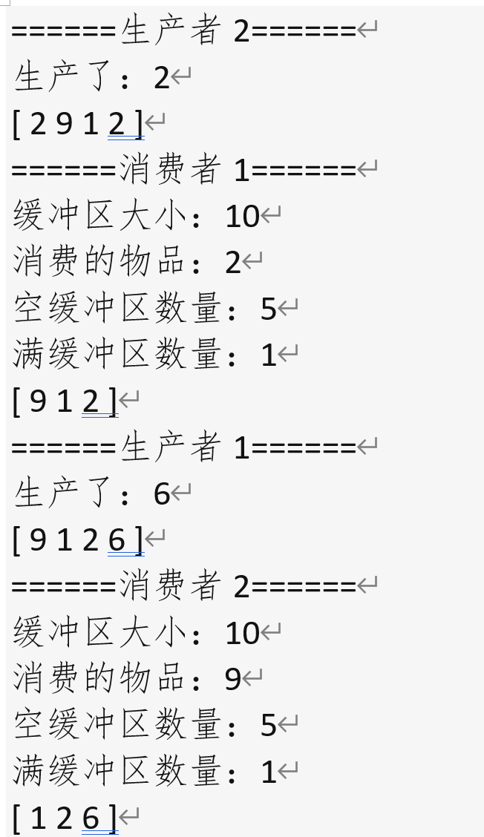
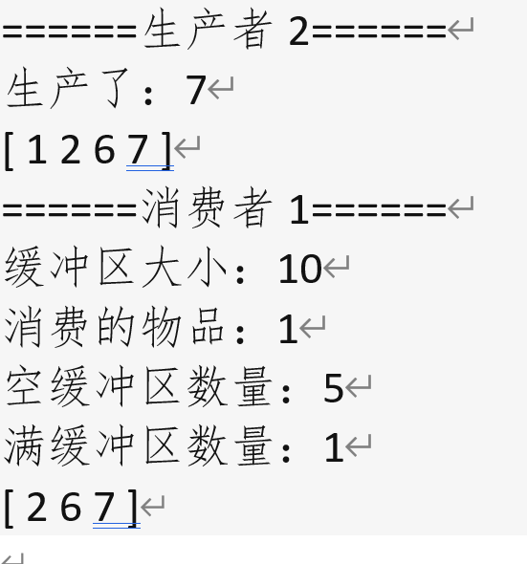
运行结果

Slide 82
6.6.2 Readers-Writers Problem
Problem description
readers, writers, concurrently access on shared data, e.g. files or database systems
Constraints
more than one reader can simultaneously enter their critical sections to access the data item
when a reader is accessing the data item, the other readers are also allowed to access, but no writer is permitted
R-R | W-R | W-W
Yes | No | No

Slide 83
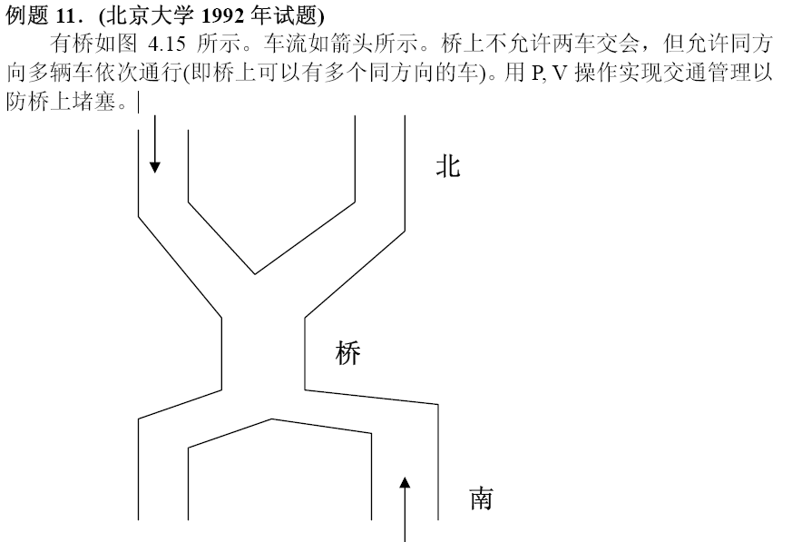
Extended Readers-Writers Problem
E.g. Soldiers in two queues, passing a bridge
two queues of readers, and each queue can be viewed as a type of readers

Slide 84
Solution to Readers-Writers Problem
Data structures
semaphore wrt /*共享数据写-写、（第一次）读-写操作的互斥信号量
readcount /*正在读的reader数目
semaphore mutex
/*访问共享变量readcount的互斥信号量
Initially wrt = 1, mutex =1, readcount = 0

Slide 85
Reader
readcount: shared variable
wrt: conditional variable
readcount++,--: procedure in monitor
wait(mutex); /*互斥访问readcount
readcount++; /*读者数加1
if (readcount == 1) /*如果是第1个读者，判断是否有写者、存在读写冲突
wait(wrt); 互斥/禁止写操作
signal(mutex); /*恢复对readcount访问*/
…
reading is performed
…
wait(mutex); /*互斥访问readcount*/
readcount--; /*读者数减1*/
if (readcount == 0) /*如果已经无readers，
signal(wrt); 恢复写操作许可*/
signal(mutex)； /*恢复对readcount访问*/
读者优先：
当一个或多个读者正在读时，有读者请求、写者请求，读者优先进入

Slide 86
Solution to Readers-Writers Problem
Writer Process: wait(wrt);
…
writing is performed
…
signal(wrt);
Note: if a writer is in its critical section while n readers are waiting,
the first reader is queued on wrt
the other n-1 readers are queued on mutex

Slide 87
第一个读者执行wait(wrt)，负责与写者争夺控制权
w3
w2
w1
r1
r2
r3
DataBase
wrt.list
mutex.list
initially, readcount=0, mutex=1,wrt=1

Slide 88
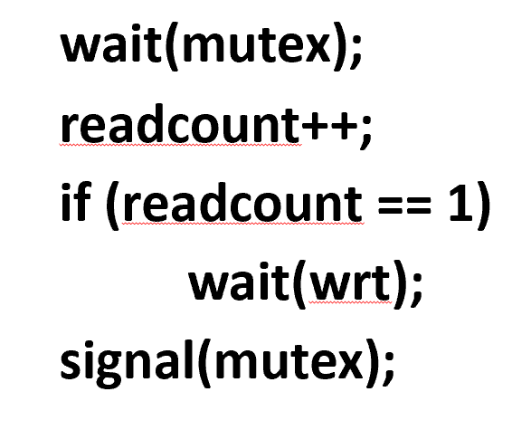
先读后写
initially, readcount=0,
mutex=1,
wrt=1
w3
w2
w1
r1
r2
r3
DataBase
w3
w2
w1
wrt.list
mutex.list
先读后写：3个读者依次进入，在临界区内并行读；当读者未完成时，稍后3个writers提出进入申请，均被阻塞：
Readers Writers wrt mutex readcount
r1 1→0 1→0→1 0→1
w1 ×
r2 1→0→1 1→2
w2 ×
r3 1→0→1 2→3
w3 X
wait(wrt);
…
writing is performed
signal(wrt);

Slide 89
先写后读
initially, readcount=0, mutex=1,wrt=1
w3
w2
w1
r1
r2
r3
DataBase
w3
w2
r1
wrt.list
mutex.list
r2
r3
先写后读：3个写者依次申请进入临界区内写；当第1个写者未完成时，稍后writers、reader提出进入申请：
Readers Writers wrt mutex readcount
w1 1→0 1 0
r1 × 1→0 0→1
w2 × 1
r2 × 1
w3 × 0
r3 × 1
wait(wrt);
…
writing is performed
signal(wrt);

Slide 90
Extended Readers-Writers Problems
例7. Extended Reader-Writer Problem 1
多队读者，没有写者
e.g. 两队士兵相向过独木桥，两车队相向通过bridge
例8. Extended Reader-Writer Problem 2
允许最多m个读者同时读
例9. Extended Reader-Writer Problem 3
m个读者依次读完，允许写者
例10. Extended Reader-Writer Problem 4
读写者公平竞争
例11. Extended Reader-Writer Problem 5
写者优先

Slide 91
POSIX/Pthread Semaphore-based Solution to Reader-Writer Problem
初始化
#include <stdio.h>
#include <stdlib.h>
#include <errno.h>
#include <pthread.h>
#include <semaphore.h>
#define N 128
int data[N];
int datap = 0;
semt_t rmutex, wmutex;
Int readCnt = 0;

Slide 92
读者 void *reader(void* id) {
sem_wait(&rmutex);
if (readCnt == 0) sem_wait(&wmutex);
++readCnt;
printf("======%s======\n", (char*)id);
for(int i=0; i<datap; ++i) printf("%c", data[i]);
puts("");
sem_post(&rmutex);
// 读操作
sem_wait(&rmutex);
--readCnt;
If (readCnt == 0) sem_post(&wmutex);
sem_post(&rmutex);
return NULL;
}

Slide 93
写者
// 随意写入一个128字节文本
void *writer(void *id) {
sem_wait(&wmutex);
// 写
if (datap == N) datap = 0;
printf("======%s======\n", (char*)id);
for(datap=0; datap < N; ++datap)
data[datap++] = rand()%26 + 'a';
sem_post(&wmutex);
return NULL;
}

Slide 94
主程序 int main()
{
// 初始化信号量
sem_init(&rmutex, 0, 1);
sem_init(&wmutex, 0, 1);
// 一个写者，3个读者
pthread_t w1, r1, r2, r3;
while(true) {
if(pthread_create(&w1, NULL, writer, (void*)"写者"))
perror("pthread_create");
if(pthread_create(&r1, NULL, reader, (void*)"读者1"))
perror("pthread_create");
if(pthread_create(&r2, NULL, reader, (void*)"读者2"))
perror("pthread_create");

Slide 95
主程序 int main()
{
while(true) {
….
if(pthread_create(&r2, NULL, reader, (void*)"读者2"))
perror("pthread_create");
if(pthread_create(&r3, NULL, reader, (void*)"读者3"))
perror("pthread_create");
if(pthread_join(r1, NULL)) perror("pthread_join");
if(pthread_join(r2, NULL)) perror("pthread_join");
if(pthread_join(r3, NULL)) perror("pthread_join");
if(pthread_join(w1, NULL)) perror("pthread_join");
}
return 0;
}

Slide 96
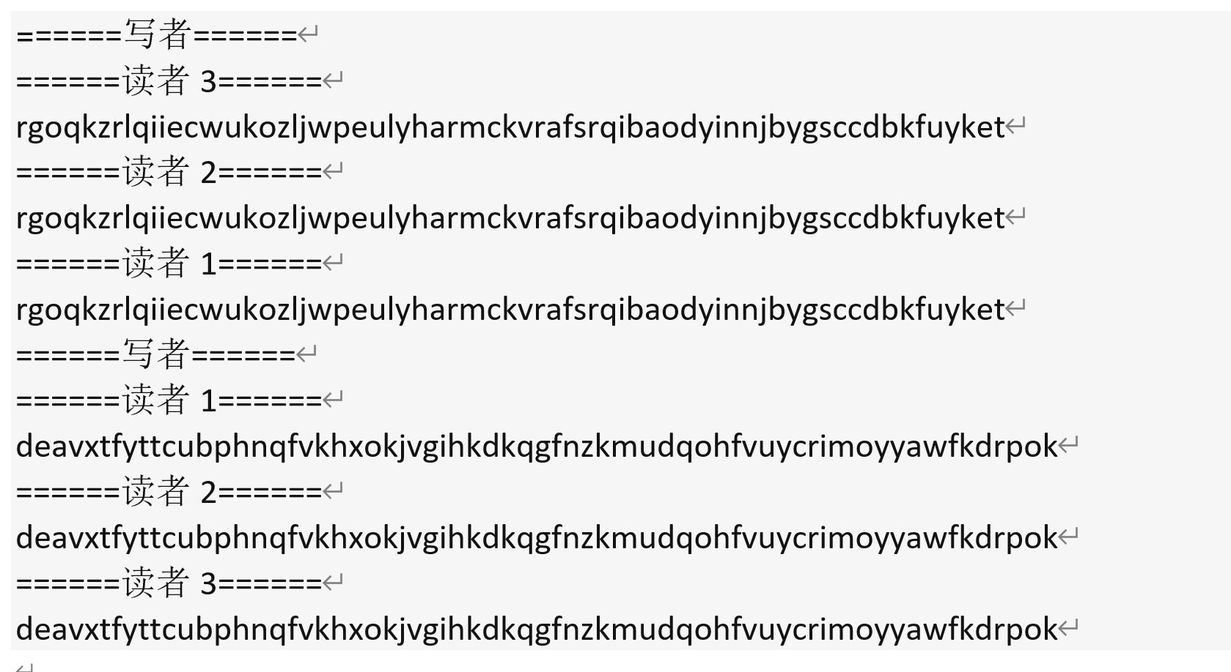
运行结果

Slide 97
6.6.3 Dining-Philosophers Problem
Problem description
five philosophers (i.e. processes), five chopsticks (i.e. resources), thinking and eating;
pick up two chopsticks that are closest to him to eat, pick up only one chopstick at a time;
once finish eating, put down both of her chopsticks, and start thinking
As a model applicable in a large class of concurrency control problems
representing the need of allocating several resources among several processes in a deadlock-free and starvation-free manner (e.g. multiple processes concurrently use shared resources, such as I/O devices)

Slide 98
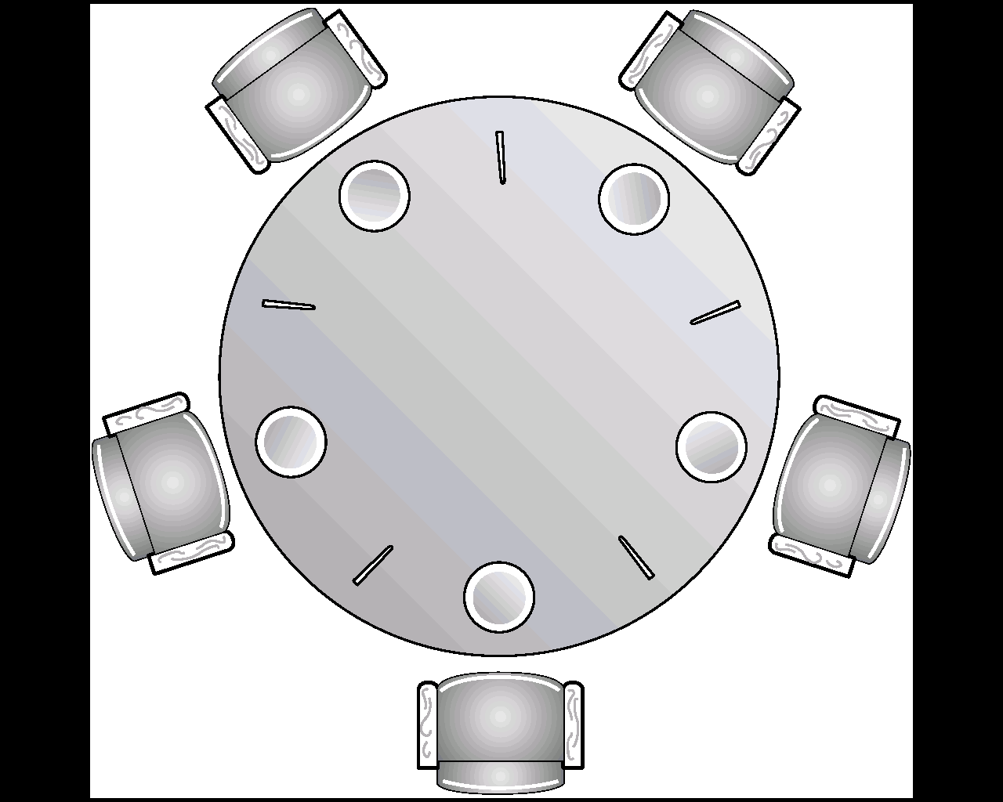
特点：
为防止死锁，进程需要同时获得2类资源：
1) 左手刀叉 2)右手刀叉
2类资源同时申请，不允许只申请一部分资源。
[i]
[i+4]
[i+1]
应用：
1. （第7章）资源预分配策略，控制死锁；
2. 课后作业：
进程执行时需要同时使用1 page 内存资源和1个I/O设备
[i+2]
[i+3]
Fig. Dining-Philosophers Problem

Slide 99
An Incorrect Solution
An incorrect ( may resulting in starvation or deadlock) solution based on semaphores
shared data
semaphore chopstick[5];
/*representing that chopstick[i] is available, 1≤ i < ≤ 5*/
, initially all values are 1

Slide 100
Philosopher i:
Philosopher i:
do {
wait(chopstick[i])
/* right chopstick*/
pickup the chopstick
wait(chopstick[(i+1) % 5])
/* left chopstick*/
pickup the chopstick
…
eating
…
signal(chopstick[i]);
signal(chopstick[(i+1) % 5]);
…
think
…
} while (1);
Properties
guarantee that no two neighbors are eating simultaneously
deadlock occurs, e.g., when each philosopher picks up her left chopsticks

Slide 101
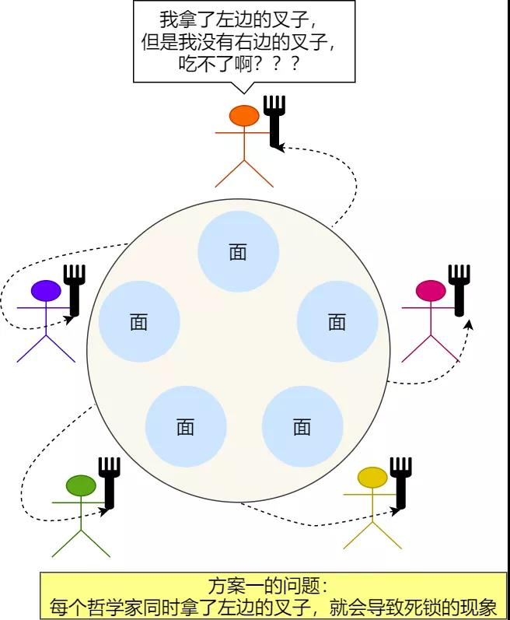
方案1及其错误

Slide 102
Dining-Philosophers Problem
Dining-Philosophers problem can also be resolved by monitors as shown in (§6.7)
A correct semaphore-based solution to this problem, similar to that in §6.7, is given

Slide 103
剩余段
A correct semaphore-based solution
enum {thinking, hungry, eating} state[5];
/*记录每个人状态*/
semaphore mutex=1;
/*临界区互斥*，保证每时刻最多只能有一个人执行从餐桌上取或放2把叉子的动作/
semaphore self[5];
/*哲学家信号量，表明i是否已获得2把刀叉并可以开始进餐*/
initially, mutex=1, state[i]=thinking, self[i]=0
进入段
临界段

Slide 104
void philosopher(int i) {
while (true) {
thinking(); /*剩余段：思考*/
pickup(i); /*进入段：同时获取两把叉子，或阻塞*/
eating(); /*临界段：进餐*/
putdown(i); /*退出段：放下两把叉子*/
};

Slide 105
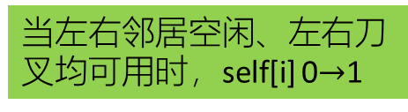
void pickup(int i) {
wait(mutex);
/*申请进入临界区访问餐桌
state[i] = hungry;
/*记录为饥饿
test[i];
/*测试左右刀叉是否可用
signal(mutex);
/*退出访问餐桌区
wait(self[i])
/* 等待左右空闲刀叉，等待获得所需
资源，如果得不到叉子则被阻塞，
}
void test(int i)
{
if ( (state[(i + 4) % 5] != eating) &&
(state[i] == hungry) &&
(state[(i + 1) % 5] != eating))
{
state[i] = eating;
signal(self[i]); /*唤醒i, 允许其进餐*/
}
}
当左右邻居空闲、左右刀叉均可用时，self[i] 0$→$1

Slide 106
void putdown(int i) {
wait(mutex); /*申请访问餐桌
state[i] = thinking; /*记录为思考
test[(i+1)%5]; /*测试左邻居是否想进餐*/
test[(i+4)%5]; /*测试右邻居是否想进餐*/
signal (mutex); /*退出访问餐桌*/
}
i进餐完毕，唤醒
可能被阻塞在self
对列的左右邻居
signal(self[i+1]%5)
signal(self[i+4]%5)

Slide 107
Extended Dinning Problems
例12. 同时申请多类资源
e.g. memory、I/O devices【习题】
例13. 哲学家就餐问题第三种解法
例14. 反例1、反例2
死锁，执行效率低

Slide 108
6.6.4 Sleeping Barber Problem
Sleeping Barber Problem
进程间同步 + 利用“用户空间计数变量 + 内核空间互斥信号量”判断buffer容量、顾客数量
A barbershop consists of a waiting room with N chairs and a barber room with one barber chair
If there are no customers to be severed, the barber goes to sleep
If a customer enters to the barbershop, and all chairs are occupied, then the customer leaves the shop
If the barber is busy but the chairs are available, the customer sits in one of free chairs. If the barber is asleep, the customer wakes up the barber

Slide 109



Waiting room: N chairs
wait(customer)
Barber room
enter
/apply
signal(customer)
……….
served
wait(barber)
leave
waitingN($≤$N) waiting customers
signal(barber)
one chair, one barber
waitingN<CHAIRS?
决定是否进入或离开
信号量customer:
customer-barber间通知是否有顾客，唤醒barber为顾客理发
barber: wait(customer)
customer: signal(customer)
信号量barber:
barber是否空闲、可以为顾客理发
barber: signal(barber)
customer: wait(barber)
busy
要求：
waiting room容量为N，当容量已满时（n个顾客等待），后续顾客离开，不能被阻塞，故引入计数变量waitingN
wait(customer)
enter
waiting
sleeping
leave
wait(barber)
served

Slide 110
Sleeping Barber Problem
Problem description in P233 in the textbook
barbershop: waiting room, barber room
n chairs in waiting room, one barber chair in barber room
customers: enter—wait or leave—severed
barber: sleep—be waken up—be busy/working
特点：
1. 资源竞争
顾客竞争chairs
顾客竞争barbers
2. 同步
顾客-barber

Slide 111
Semaphore customer
the number of waiting customers
binary semaphore barber
barber-customer间的同步/唤醒信号量
int waitingN
the number of waiting customers, a copy of semaphore customers
binary semaphore mutex
for mutual exclusion on the variable waitingN
Initially
customers=0, barber=0, mutex=1
waitingN=0, CHAIRS=N /*椅子数目
customer-barber间通知是否有顾客，唤醒barber为顾客理发
barber: wait(customer)
customer: signal(customer)
barber是否可以为顾客理发
barber: signal(barber)
customer: wait(barber)
customer表示顾客总数，但无法与椅子总数N进行比较，引入:
1) waitingN作为customer的copy,
2) mutex控制互斥访问waitingN

Slide 112
Barber
Void Barber(void) {
while (true) {
wait(customers); /*如果无等待顾客，则睡觉
wait(mutex); /*服务顾客，将等待顾客数减1
waitingN:=waitingN-1;
signal(mutex);
signal(barber); /*理发师召唤1个等待顾客，开始理发
cut-hair() }
}
barber工作前提：有等待顾客，wait(customers)

Slide 113
Customer
Void Customers(void) {
wait(mutex);
if (waitingN < CHAIRS) { /*判断是否有空椅子，等待
waitingN:= waitingN+1;
signal(customers); /*通知理发师，有等待顾客
signal(mutex);
wait(barber); /*请求理发师为自己服务*/
get-hair()
}
else /*如果客满无空椅子，离开
{ signal(mutex)
}
}
顾客被服务前提：
1. 有空椅子，可以等待，waitingN<CHAIRS；
2. 被理发师召唤, wait(barber)

Slide 114
6.7 Monitors
Monitor(管程)
a type of high-level synchronization construct (i.e. not in kernel space) that allows the safe sharing of an abstract data type among concurrent processes
provided by programming environments ( such as Concurrent C, Java, C#)
Why the monitor needed ?
process synchronization on the basis of semaphores is somewhat difficult for the application programmers
disorders of the wait and signal operations in application programs may result in deadlock
to avoid this demerit, the critical sections in programs are controlled by a centralized controller, i.e. the monitor, provided by programming languages or middleware
管程”定义
由程序设计语言/环境（e.g. Java, Concurrent C）提供的一种进程同步互斥机制
将分散在应用进程中互斥访问临界/共享资源的临界区代码集中到管程内部，统一地管理
管程可以控制共享资源，为访问这些共享资源提供一种互斥机制
形式上，管程 = 局部于管程内部的公共共享变量 + 访问这些变量的过程
公共共享变量代表共享资源，过程对应于临界区代码

Slide 115
Monitors Representation
monitor monitor-name
{
shared variable declarations
procedure body P₁ (…) {
. . .
}
procedure body P₂ (…) {
. . .
}
procedure body P_{n} (…) {
. . .
}
{
initialization code
}
}
Procedure P₁,P₂,…,P_{n} operate on shared variables declared within the monitor
Monitor consists of
shared variables
concurrent procedures, e.g. producers, consumers
initialization codes
Monitor construct ensures that only one process at a time can be active within the monitor ( access the shared variables by calling P₁, P₂, …,P_{n})
act as mutual exclusive semaphore mutex

Slide 116
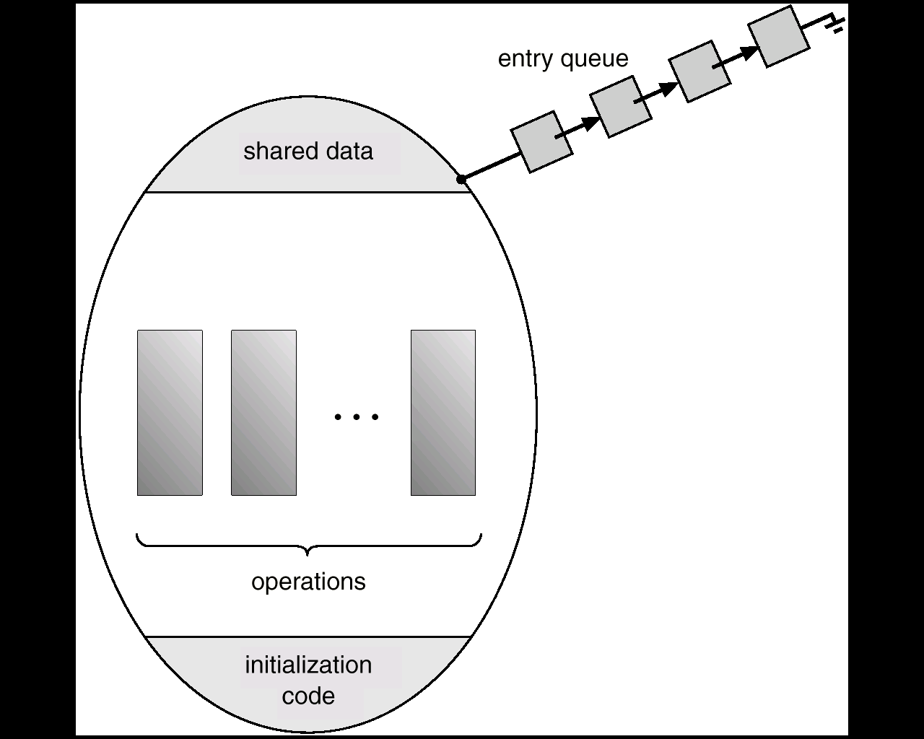
Fig. Schematic view of a monitor 301-303
monitor pc
{
shared variable buffer
void add(int i)
void remove(int i)
initialization code
}
void add( int i) {
add nextp to buffer
}
Producer i:
wait(empty)
pc.add
signal(full)
P₁
P₂
P_{n}
high-level
synchronization construct
替代了对buffer的mutex

Slide 117
Monitor
Improvement
to refining the synchronizing ability of the monitor, a process can be allowed to wait within the monitor, so condition variables are introduced into the monitor, which are declared, as:
condition x, y
Monitor consists of
shared variables
conditional variables
concurrent procedures
initialization codes
Fig. 6.18

Slide 118
Monitor
Condition variable can only be used with the operations wait and signal. These two operators are in procedures P₁, P₂, …, P_{n}
x.wait() means that the process invoking this operation is suspended until another process invokes
x.signal()
the x.signal operation resumes exactly one suspended process. If no process is suspended, then the signal operation has no effect

Slide 119
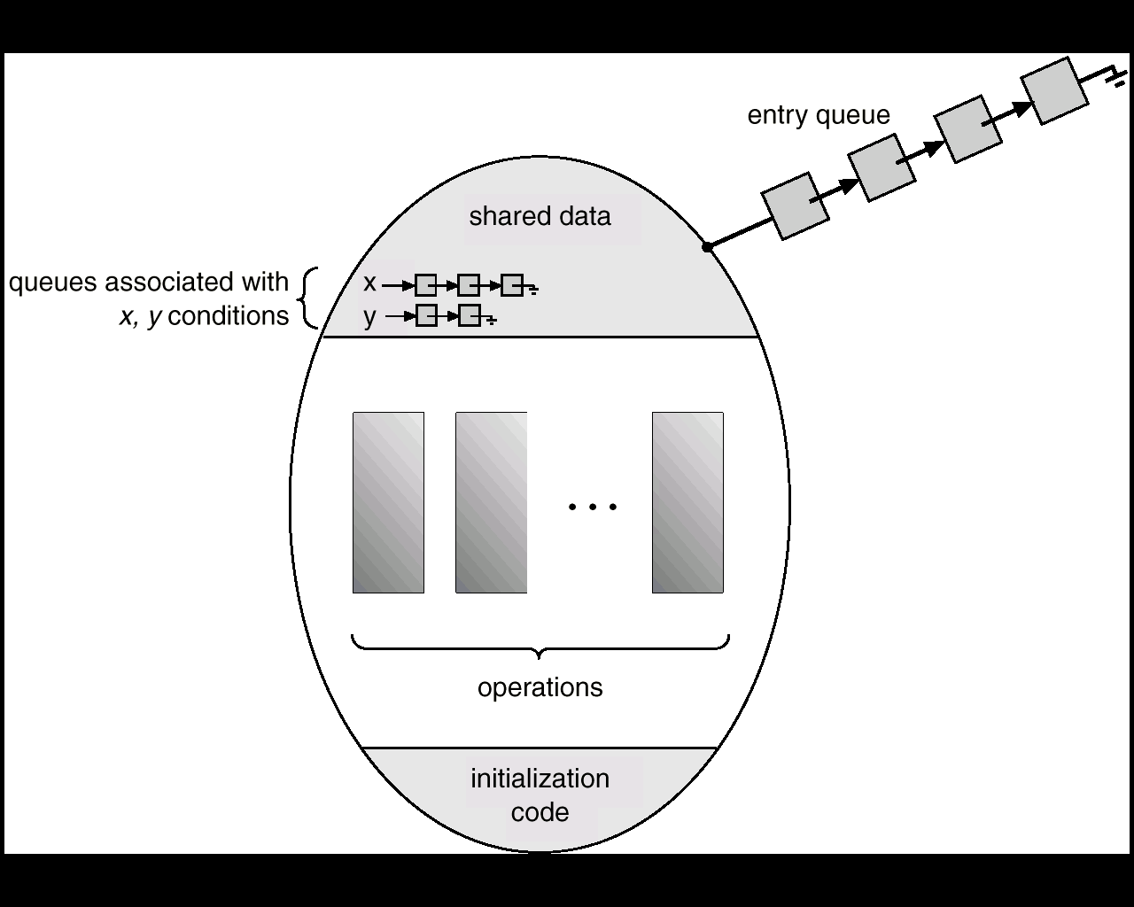
Fig. Monitor With Condition Variables
P₁
P₂
P_{n}

Slide 120
Bounded-buffer Monitor
monitor pc
{
shared variable buffer
condition empty, full
void add(int i)
void remove(int i)
void init() {
empty=n;
full=0
}
}
void add(int i) {
empty.wait
access and add nextp to buffer
full.signal
}
void remove(int i) {
full.wait
access and remove from buffer
to nextc
empty.signal
}
Producer i:
pc.add(i)
Consumer i:
pc.remove(i)

Slide 121
Monitor for Dining Philosophers
Monitor dp
{
1. enum {thinking, hungry, eating} state[5];
2. condition self[5];
3. void pickup(int i)
void putdown(int i)
void test(int i)
4. void init() {
for (int i = 0; i < 5; i++)
state[i] = thinking;
}
}
----- shared variables
-----conditional variables
concurrent procedures
initialization code

Slide 122
Monitor for Dining Philosophers
void pickup(int i) {
state[i] = hungry;
test[i];
if (state[i] != eating)
self[i].wait();
}
void putdown(int i) {
state[i] = thinking;
/* test left and right neighbors
test((i+4) % 5);
test((i+1) % 5);
}
void test(int i) {
if ( (state[(i + 4) % 5] != eating) &&
(state[i] == hungry) &&
(state[(i + 1) % 5] != eating)) {
state[i] = eating;
self[i].signal();
}
}
Philosopher i:
dp.pickup (i)
eat
dp.putdown(i)

Slide 123
Monitor vs Semaphore
Monitors are implemented by semaphores
For more details, refer to Appendix 6-2
Monitors vs Semaphores
refer to next slide

Slide 124
信号量方式 | 管程【条件变量condition variable】
互斥访问的资源/变量, e.g.1 buffer e.g.2 shared data; readcount e.g.3 餐桌; state[i] | monitor; shared variables 说明：管程自动实现对管程所代表的资源或管程内shared variables的互斥访问，因此不需要单独定义类似于binary semaphores mutex角色的结构
binary semaphores: 对临界资源/变量互斥访问 e.g.1 mutex e.g.2 wrt, mutex e.g.3 mutex
counting semaphores e.g.1 empty, full; e.g.2 self[i]; | conditional variable x + 用户空间计数变量
wait(), signal() on counting semaphores | x.wait(), x.signal() on conditional variables
concurrent processes的各个业务逻辑步骤 | concurrent procedures
shared variables, binary semaphores, counting semaphores初始化 | initialization code: 对shared variables，conditional variables 初始化 说明：无binary semaphores

Slide 125
Monitors vs Semaphores
以管程方式实现的并发进程，其业务逻辑由一系列顺序步骤组成；
当其中某些业务逻辑步骤需要访问临界资源时，需要采用定义在管程内的procedures
如果进程在其生命周期内需要顺序访问多个临界资源，每个临界资源通过一个管程来控制对其互斥访问，则进程的业务逻辑步骤中会调用来自多个管程的procedures
e.g. “小和尚-老和尚挑水取水”中水井、水缸、水桶

Slide 126
实际编程环境下的Condition Variable【条件变量】
利用condition variable，避免线程忙等待
条件变量对应的某种特定条件是否满足
如是否有空缓冲区 empty_cond、是否有满缓冲区full_cond
在用户空间中，定义特定条件的具体形式，判断该特定条件是否满足
条件“有空缓冲区”：int empty, empty>0
条件“用满缓冲区”：int full, full>0
条件变量与互斥锁搭配使用，互斥锁用于保护对特定条件的判断，e.g.
lock(mutex)
if (empty=0) //无空缓冲区
then 使用定义在empty_cond上
的cond_wait操作，挂起本线程
empty--
unlock(mutex)
lock(mutex)
if (full=0) //无满缓冲区
then 使用定义在full_cond上
的cond_wait操作，挂起本线程
full--
unlock(mutex)

Slide 127
Condition Variable【条件变量】
利用定义在条件变量上的访问接口cond_wait，在条件变量代表的条件不满足时，挂起线程
cond_wait的参数：cond_wait(条件变量，搭配使用的锁)
利用定义在条件变量上的访问接口cond_signal，在条件变量代表的不满足时，唤醒被挂起的线程
cond_signal的参数：cond_signal(条件变量)

Slide 128
基于条件变量和互斥锁的生产者-消费者问题
1 int empty=5;
2 struc cond empty_cond;
3 lock empty_cnt_lock;
4 int full=0;
5 struc cond full_cond;
6 lock full_cnt_lock;
7
8 void producer(void)
9 {
10 int new_msg;
11 while (true) {
12 new_msg=producer_new();
13 lock(&empty_cnt_lock); //加锁
14 while (empty==0) //利用变量empty，判断条件
“有空缓冲区””
15 cond_wait(&empty_cond, &empty_cnt_lock);
//条件不满足时，挂起
16 empty-- ;
17 unlock(&empty_cnt_lock); //解锁
18
19 buffer_add_safe(new_mag);
20
21 lock(&full_cnt_lock);
整型变量
条件变量
锁
整型变量
条件变量
锁

Slide 129
基于条件变量和互斥锁的生产者-消费者问题
21 lock(&full_cnt_lock); //加锁
22 full++;
23 cond_signal(&full_cond); //唤醒被阻塞在条件变量full_cond上
的消费者线程
24 unlock(&full_cnt_lock); //解锁
25 }
26 }
27

Slide 130
基于条件变量和互斥锁的生产者-消费者问题
27
28 void consumer(void)
29 {
30 int cur_msg;
31 while (true) {
32 lock(&full_cnt_lock); // 加锁
33 while (full==0) //无满缓冲区
34 cond_wait(&full_cond, &full_cnt_lock);
//条件不满足，阻塞线程
35 full--;
36 unlock(&full_cnt_lock); //解锁
37
37
38 cur_msg=buffer_remove_safe();
39
40 lock(&empty_cnt_lock);//加锁
41 empty++;
42 cond_signal(&empty_cond);
// 唤醒阻塞在empty_cond上的
生产者线程
43 unlock(&empty_cnt_lock);
44 consume_msg(cur_msg);
45 }
46 }

Slide 131
C++11中基于条件变量和互斥锁的生产者-消费者问题
c++11中条件变量（condition variable）std::condition_variable与互斥锁std::mutex一起使用, 提供了#include <condition_variable>头文件
条件变量接口
wait()：条件变量对应的条件不满足，阻塞线程
notify()：条件变量满足，唤醒线程
#include <iostream>
#include <deque>
#include <thread>
#include <mutex>
#include <condition_variable>

Slide 132
std::deque<int> q;
std::mutex mu;
Std::condition_variable cond;
void function_1() {
int count = 10;
while (count > 0) {
std::unique_lock<std::mutex> locker(mu);
q.push_front(count);
locker.unlock();
cond.notify_one();//Notify one waiting thread,
if there is one.
std::this_thread::sleep_for(std::chrono::seconds(1));
count--;
}
}

Slide 134
void function_2() {
int data = 0;
while ( data != 1) {
std::unique_lock<std::mutex> locker(mu);
while(q.empty())
cond.wait(locker); // Unlock mu and wait to be notified
data = q.back();
q.pop_back();
locker.unlock();
std::cout <<"t2 got a value from t1:"<<data<< std::endl;
}
}

Slide 135
int main() {
std::thread t1(function_1);
std::thread t2(function_2);
t1.join();
t2.join();
return 0;
}

Slide 136
基于“二元信号量+整型计数变量”的生产者-消费者问题
教科书上的计数、多元信号量empty、full等同时实现资源计数和线程互斥访问控制，可以用“用户整型变量+二元信号量”替代
在前述基于条件变量的生产者-消费者样例中，将条件变量cond_empty、cond_full替换为两个二元互斥信号量empty_mutex、full_mutex，并引入挂起信号量suspend_P、suspend_C，就可以实现基于二元信号量的生产者-消费者问题
假设：有多个生产者、消费者，允许一个生产者和一个消费者同时进入缓冲区，分别向不同的空缓冲单元写入数据项和从满缓冲单元读取数据项；不允许多个生产者同时进入缓冲区写数据，也不允许多个消费者同时进入缓冲区读取数据。

Slide 137
基于“二元信号量+整型计数变量”的生产者-消费者问题
1 int empty=5;
2 int full=0;
3 semaphore empty_mutex=1;
4 semaphore suspend_P=0;
5 semaphore full_mutex=1;
semaphore suspend_C=0;
mutexP=1
mutexC=1;
6 void producer(void)
7 {
8 int new_msg;
11 while (true) {
12 new_msg=producer_new();
13 wait(empty_mutex); //加锁
14 if (empty==0) //判断“无空缓冲区””
15 { signal(empty_mutex); wait(suspend_P) };
//条件不满足时，挂起
16 else {empty-- ;
17 signal(empty_mutex); //解锁
};
18 wait(mutexP); //竞争buffer访问权
19 buffer_add_safe(new_mag); //进入临界区写数据
20 signal(mutexP);

Slide 138
基于“二元信号量+整型计数变量”的生产者-消费者问题
21 wait(full_mutex); //加锁
22 full++;
23 signal(suspend_C); //唤醒被阻塞的消费者
24 signal(full_mutex); //解锁
25 }
26 }
27
说明：
对多元信号量empty，用整型变量empty、二元互斥信号量empty_mutex、二元挂起信号量suspend_P替代：
用整型变量empty替代多元信号量的empty的资源计数功能；
用empty_mutex控制对整型变量empty的++、--的互斥访问；
当无空缓冲区单元时，通过wait(suspend_P)，挂起生产者
类似地，多元信号量full，用整型变量full、二元互斥信号量full_mutex、二元挂起信号量suspend_C替代

Slide 139
基于“二元信号量+整型计数变量”的生产者-消费者问题
28 void consumer(void)
29 {
30 int cur_msg;
31 while (true) {
32 wait(full_mutex); // 加锁
33 if (full==0) //无满缓冲区
34 {signal(full_mutex); wait(suspend_C)};
//条件不满足，阻塞线程
35 else { full--;
36 signal(full_mutex); //解锁
}
37 wait(mutexC);
37 cur_msg=buffer_remove_safe();
38 signal(mutexC);
39
40 wait(empty_mutex); //加锁
41 empty++;
42 signal(suspend_P);
// 唤醒阻塞的生产者
43 signal(empty_mutex);
44 consume_msg(cur_msg);
45 }
46 }

Slide 140
总 结
软件同步适用于单CPU/单核系统
e.g. 反例：多/双核4线程系统上的Bakery同步
信号量/硬件/管程等其它几种机制适用于单、多CPU系统，特别是硬件指令、自旋锁
e.g. 多核系统中的随机数发生
e.g. “利用流水线和锁提高服务器吞吐量”

Slide 141
Appendix 6-1 Synchronization Hardware (§6.3)
Two schemes of hardware synchronization by machine instrcutions
Test and Modify
Swap
Test and modify the content of a word atomically, by TestAndSet instruction
/* 测试布尔变量target的值并返回，再将其设置为true
boolean TestAndSet(boolean *target) {
boolean rv = *target;
*target = true;
return rv;
}

Slide 142
Test and Set
If two TestAndSet instructions are executed simultaneously (each on a different CPU), they will be excecuted sequentially in an arbitrary orders
To conduct mutual exclusion on a type of resource, declare a Boolean variable lock, specific to the resource and initialized to false
The processes utilize TestAndSet instructions on this lock to mutual exclusively access the resource, as follows
shared data boolean lock = false /*表示没有加锁，无用户访问

Slide 143
Process P_{i} P_{j}
do {
while (TestAndSet(lock)) ;
critical section
lock = false;
/*释放锁，允许其它进程进入
remainder section
}
lock
do {
while (TestAndSet(lock)) ;
/*busy-waiting
while (TestAndSet(lock)) ;
critical section
lock = false; /*释放，允许其它进程进入
remainder section
}
F
/* false→true, 加锁，阻止其它进程
T
F
/* false→true, 加锁，阻止其它进程)
T
F
TestAndSet (lock)
{ boolean rv = lock
lock = true;
return rv;
}
P_{i}
P_{j}
lock

Slide 144
Swap
Atomically swap two variables
void Swap(boolean &a, boolean &b) {
boolean temp = a;
a = b;
b = temp;
}
Shared data (initialized to false，表示资源没被占用):
boolean lock;

Slide 145
方案1
shared data (initialized to false，表示资源没被占用): boolean lock;
Process P_{i}
do {
key = true;
while (key == true)
Swap(lock,key);
critical section
lock = false; /*退出段，释放锁
remainder section
}
问题：
busy-waiting，do not meet the bounded-waiting requirement
/*进入段，lock=true时，资源被占，陷入while忙等待
不断测试lock—资源可用性，并通过key传到while
key=lock=false时，资源空闲，进入临界段

Slide 146
Process P_{i}
do {
waiting[i]=true;
key = true;
while (waiting[i]&&key )
key=TestAndSet(lock);
waiting[i]=false;
critical section
j=(i+1) %n;
while ((j!=i) && !waiting[j])
j = (j+1) %n
if (j==i)
lock=false
else
waiting[j]=false;
remainder section
}
方案2
Shared data (initialized to false):
boolean lock; boolean waiting[n];
1
bounded-waiting mutual
exclusion with TestAndSet
/*进入段，lock, waiting[i]=true时，资源被占，陷入while:等待
表明自身不再需要等待
考察并释放
其它等待进程,使这
些进程跳出while循环

Slide 147
Appendix 6-2 Monitor Implementation Using Semaphores
Variables
semaphore mutex; // (initially = 1)
semaphore next; // (initially = 0)
int next-count = 0;
Each external procedure F will be replaced by
wait(mutex);
…
body of F;
…
if (next-count > 0)
signal(next)
else
signal(mutex);
Mutual exclusion within a monitor is ensured.

Slide 148
Monitor Implementation Using Semaphores
For each condition variable x, we have:
semaphore x-sem; // (initially = 0)
int x-count = 0;
The operation x.wait can be implemented as:
x-count++;
if (next-count > 0)
signal(next);
else
signal(mutex);
wait(x-sem);
x-count--;

Slide 149
Monitor Implementation Using Semaphores
The operation x.signal can be implemented as:
if (x-count > 0) {
next-count++;
signal(x-sem);
wait(next);
next-count--;
}

Slide 150
Monitor Implementation Using Semaphores
Conditional-wait construct: x.wait(c);
c – integer expression evaluated when the wait operation is executed.
value of c (a priority number) stored with the name of the process that is suspended.
when x.signal is executed, process with smallest associated priority number is resumed next
Check two conditions to establish correctness of system:
User processes must always make their calls on the monitor in a correct sequence.
Must ensure that an uncooperative process does not ignore the mutual-exclusion gateway provided by the monitor, and try to access the shared resource directly, without using the access protocols

Slide 151
Appendix 6-3 Linux 进程同步互斥机制

Slide 152

Thanks for your attention

